Slide 1






eProtect: An evaluation of electronic filing for DVPO cases in North Carolina
March 2022
SAVIR in Washington DC
Funded by the National Institute of Justice, Grant # 2019-X1584-NC-SI. Points of view in this document are those of the author and do not necessarily represent the official position or policies of the US Department of Justice.
Notes:
Good afternoon, my name is Julie Kafka. I’m a doctoral candidate at UNC Gillings and a research fellow for the UNC Injury and Violence Prevention Research Center. Today I’ll be sharing our findings on the effects electronic filing for domestic violence protective order requests in North Carolina.
This work, what we call the ePrtoect study, was funded by the Department of Justice, Office on Violence Against Women. We have no other disclosures.

Slide 2
Setting up DiD
(relative to CITS ARIMA)

Slide 3
Month-Year | Time | Outcome | Policy | Posttime
2018-02 | -4 | 34.6 | 0 | 0
2018-03 | -3 | 33.7 | 0 | 0
2018-04 | -2 | 33.5 | 0 | 0
2018-05 | -1 | 35.3 | 0 | 0
2018-06 | 0 | 34.9 | 0 | 0
2018-07 | 1 | 33.2 | 1 | 1
2018-08 | 2 | 32.1 | 1 | 2
2018-09 | 3 | 34.3 | 1 | 3
2018-10 | 4 | 32.7 | 1 | 4
2018-11 | 5 | 32.5 | 1 | 5
2018-12 | 6 | 33.2 | 1 | 6
…. | … | … | … | …
Single series setup: One row for each pooled time period
Variables:
Outcome
Time: Time counter centered on the intervention date.
Policy: Turns on (0/1) after implementation
Posttime: Turns on after implementation and starts counting up (0/1, 2, 3, 4…)

Slide 4
ITS with comparison : one row for each pooled time period among intervention counties and one row for each pooled time period among control counties
Month-Year | Time | Outcome | Policy | Posttime
2018-04 | -2 | 33.5 | 0 | 0
2018-05 | -1 | 35.3 | 0 | 0
2018-06 | 0 | 34.9 | 0 | 0
2018-07 | 1 | 33.2 | 1 | 1
2018-08 | 2 | 32.1 | 1 | 2
2018-09 | 3 | 34.3 | 1 | 3
…. | … | … | … | …
Group | Grp*Time | Grp*Policy | Grp*posttime
1 | -2 | 0 | 0
1 | -1 | 0 | 0
1 | 0 | 0 | 0
1 | 1 | 1 | 1
1 | 2 | 1 | 2
1 | 3 | 1 | 3
…
0 | 0 | 0 | 0
0 | 0 | 0 | 0
0 | 0 | 0 | 0
0 | 0 | 0 | 0
0 | 0 | 0 | 0
Intervention group
2018-05 | -1 | 36.3 | 0 | 0
2018-06 | 0 | 34.5 | 0 | 0
2018-07 | 1 | 34.9 | 1 | 1
2018-08 | 2 | 35.4 | 1 | 2
2018-09 | 3 | 34.1 | 1 | 3
Control group

Slide 5
P(Outcome) = β₀ + β₁*Policy + β₂*Group + β₃*group*policy
Variables used in in DiD with comparison :
Intercept: Existing starting rate (combined/mean of intervention and control groups)
Time: Existing trend (in the control group)
Policy: Post-intervention level change (combined in intervention and control groups)
Posttime: Post-intervention trend change (in the control group)
Group: Overall difference between intervention and control groups
Grp*Time: Existing trend difference (between intervention and control groups)
Grp*Policy: DiD estimate of the effect of policy in the intervention group relative to the control group
Grp*Posttime: Post-intervention sustained trend change (trend change difference between intervention and control groups)

Slide 6
Results
Notes:
Results are shown based on any change that we observed 2 years after e-filing was implemented.

Slide 7

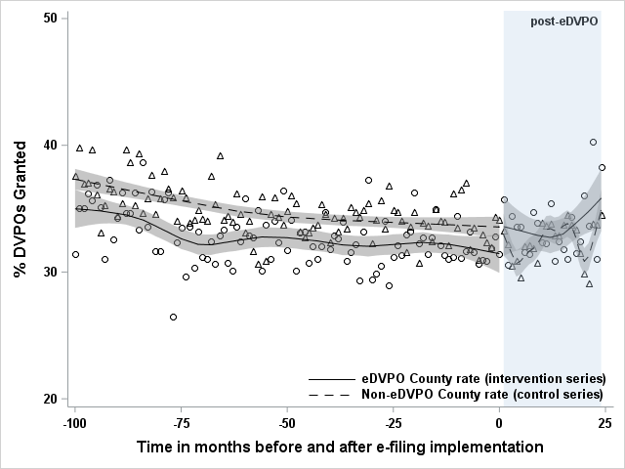
DVPO granting: No significant changes
CITS results
Immediate change: 2.27 percentage point increase (-0.16, 4.71)
Sustained change: 0.01 percentage point increase (-0.14, 0.17)
DiD results
Overall change: 3. 05 percentage point increase (1.74, 4.32)
Notes:
There were no significant changes in granting rates after e-filing was implemented for intervention counties. Non-significant findings are in grey.
Let me at least walk you through how we might interpret the graph here. The immediate change would be visible here. While we do see a sustained increase in DVPO granting rates for both e-filing and control counties, there was no significant difference when comparing the two groups.
~~~
[Because the rates for comparison counties are so jumpy, that may be why we don’t see an effect, but we would need to examine data over a longer time period to determine that. ]
[having the comparison actually may make us more conservative, but adds methodological rigor]

Slide 8
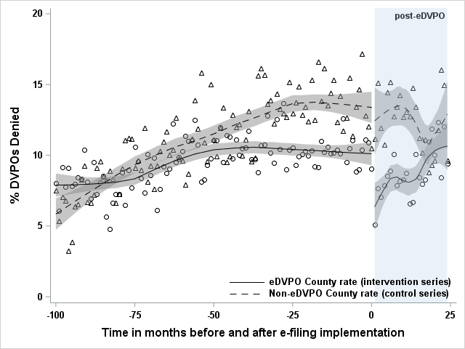
DVPO denials: Immediate decrease, sustained (small) increase
CITS results
Immediate change: -2.63 percentage point decrease (-4.74, -0.52)*
Sustained change: 0.29 percentage point increase (0.16, 0.43)*
DiD results
Overall change: -2.04 percentage point decrease (-3.49, -0.60)*
Notes:
For denials, we did see some significant results, noted with an asterisk. There was an immediate decrease, but a sustained, small increase in denial rates in the long-term for e-filing compared to control counties. Which we think effectively have been a quirk that then corrected itself over time

Slide 9
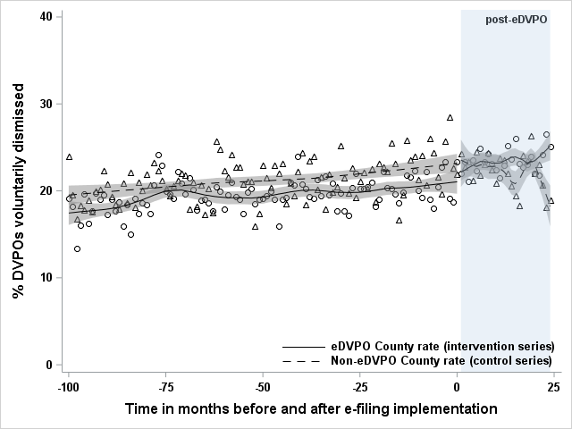
Voluntary dismissals: Sustained (small) increase
CITS results
Immediate change: 0.96 percentage point increase (-1.51, 3.42)
Sustained change: 0.19 percentage point increase (0.03, 0.35)*
DiD results
Overall change: 2.90 percentage point increase (1.60, 4.19)*
Notes:
There were no immediate changes for involuntary dismissal rates, but there was a very small sustained increase after e-filing implementation

Slide 10
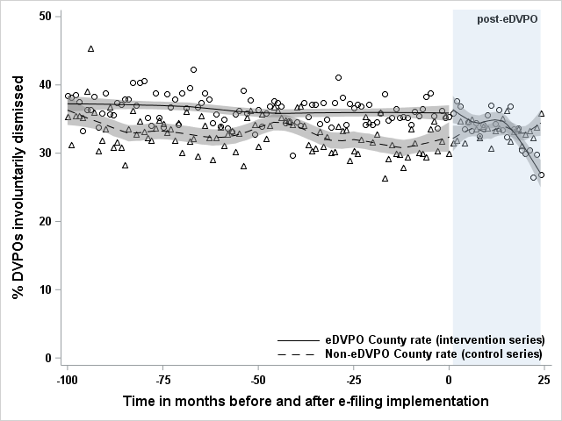
Involuntary dismissals: Sustained decrease
CITS results
Immediate change: -0.09 percentage point decrease (-2.80, 2.98)
Sustained change: -0.36 percentage point decrease (-0.55, -0.18)*
For e-filing counties, there were 790 fewer involuntary dismissals due to e-filing over the two-year post implementation period
DiD results
Overall change: -3.49 percentage point decrease (-5.00, -1.98)*
*Significant findings
Notes:
The biggest impacts we saw were in the rates of involuntary dismissals, which we saw go down substantially; this amounts to a decrease of 3.6 involuntary dismissals per 1,000 filed cases per month.
While that does sound small… taken at a systems-level, that means there were nearly 800 fewer involuntary dismissals due to e-filing over the two-year post implementation time period.
____________
Sustained trend – If you just multiplied .36 by 24, then you would only get the difference at the end of the follow-up period. This is a TREND, so need to take into account changes from the previous month, this is a cumulative impact here. So… 24 + 23 + 22 + 21 etc. We’re calculating the shaded area between the counterfactual line and the observed line for the intervention counties.
If the entire state implemented e-filing, we would have approximately 2,880 fewer involuntary dismissals for the first two years after implementation

Slide 11

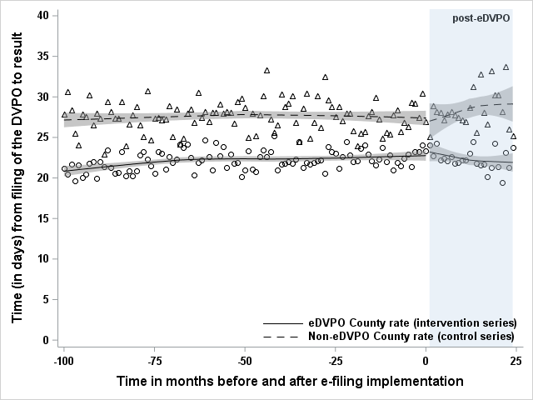
Time to DVPO disposition: Sustained decrease
CITS results
Immediate change: 0.49-day increase
(-1.62, 2.61)
Sustained change: -0.16-day decrease
(-0.29, -0.02)*
For e-filing counties, this amounted to 48 FTE saved for the court/legal system due to e-filing over the two-year post implementation period
DiD results
Overall change: -0.70-day decrease (-1.74, 0.34)
Notes:
And finally, results showed that e-filing clearly expediated the DVPO process overall.
In total, E-filing saved the court/legal system a total of 48 FTE equivalent time over the two-year period. Which is pretty substantial.

Slide 12
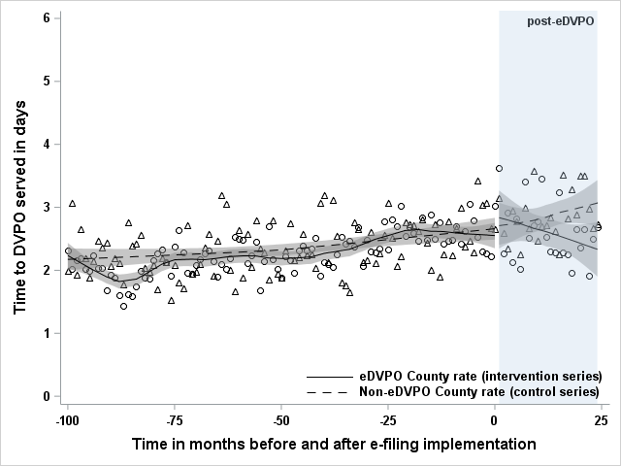
Time to DVPO service: Sustained decrease
CITS results
Immediate change: 0.13-day increase
(-0.31, 0.58)
Sustained change: -0.04-day decrease (-0.07, -0.01)*
For e-filing counties, this amounted to 12 FTE saved for the court/legal system due to e-filing over the two-year post implementation period
DiD results
Overall change: -0.18-day decrease (-0.42, 0.06)
Notes:
E-filing also led to a sustained decrease in the time it took to serve a DVPO civil summons.
Across the entire post-implementation period, this amounted to 12 FTE worth of time saved for the court/legal system. So it really adds up.
______________
Can’t really sum this up because we used calendar data, rounding to that nearest unit.
0.04 days is not the same as .96 hours. We didn’t measure it fine-grained enough to talk about hours saved.
One person is employed for a year (regardless of how many hours they work!!!) –
12 people would need to be employed for an entire two-year period to keep up with the added work of having no e-filing.
If we save 12,000 person-days, that’s like 16 years of work time saved.

